Slide 1

Stroke prediction
Saurabh Biswas
DSC-680
Bellevue University

Slide 2
Contents
Problem Statements
Proposal
Why Data Science
High Level Process Overview
Data
Data Cleaning & Exploratory Data Analysis
Model
Comparison
Test Results
Conclusion

Slide 3
Problem statements
Stroke is the 2nd leading cause of deaths worldwide.
11% deaths are caused by stroke – WHO.
Someone dies because of stroke in every 4 minutes in USA.
Identifying people from high-risk group early can avoid stroke.

Slide 4
proposal
Machine Learning Technique to Detect people at risk of getting a stroke
Random Forest, Logistic Regression & Artificial Neural Network.
Training and Cross Validation.
Compare performance.
Select & Test the Best Model.

Slide 5
Why data science ?
Use Machine Learning to analyze different Stroke risk factor
Machine Learning techniques minimize human intervention
Identify people with Higher Risk at Stroke
High Risk Group can take precautions and do regular checkups

Slide 6
Process overview
Gather Sample Data from Kaggle.
Perform Basic Analysis on the Data.
Carry Out Exploratory Data Analysis
Split into Train & Test.
Data Cleaning
Data Preparation – SMOTE & RobustScaler.

Slide 7
Process overview
Parameter Tuning and Train Models.
Compare Cross Validation Matric.
Test the Best Model.
Train on Entire Dataset.

Slide 8
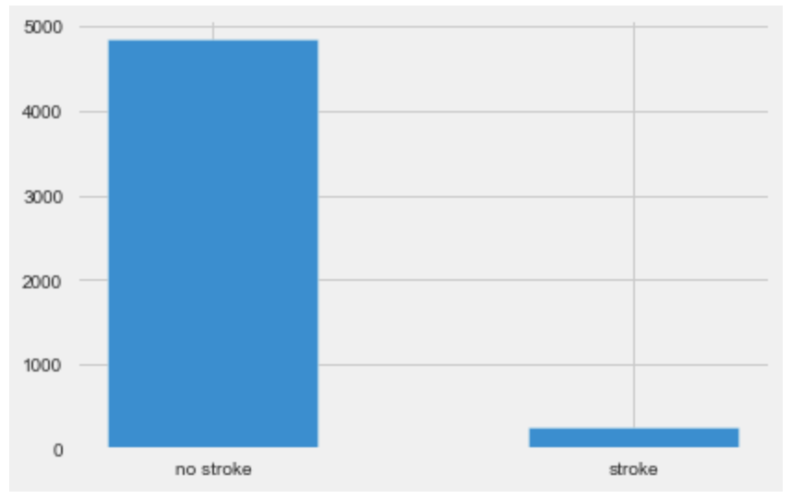
data
I’m using healthcare-dataset-stroke-data.csv from Kaggle.
5110 Observations – Output Class 1 (stroke), 0 (no stroke).
Highly imbalanced dataset – only 249 (4.87%) stroke patients.
10 important features
gender
age
hypertension
heart_disease
ever_married
work_type
Residence_type
avg_glucose_level
bmi
smoking_status

Slide 9
Data Cleaning & Exploratory Data Analysis
201 missing data in bmi column
Replaced missing data with average
Dropped ‘id’ column
Converted character string values into one-digit numbers for certain variable – gender, ever_married, work_type, Residence_type & smoking_status
‘age’, ‘glucose_level’ etc. have greater influence on stroke.
Removed Outliers from avg_glucose_level.

Slide 10
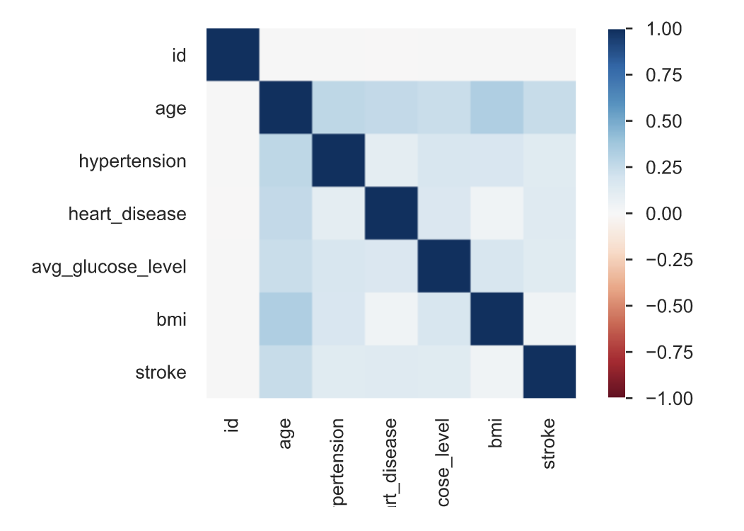
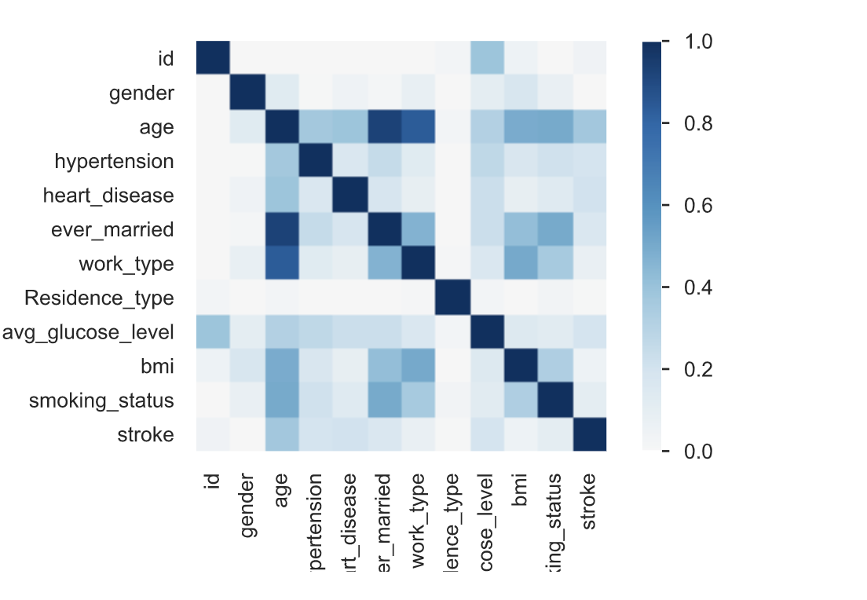
Correlation heat map

Slide 11
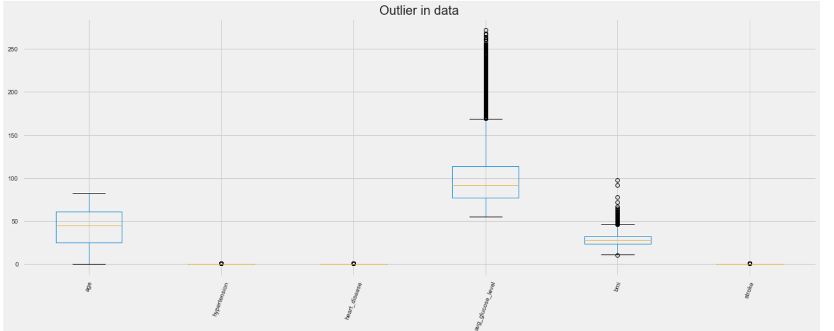
outliers

Slide 12
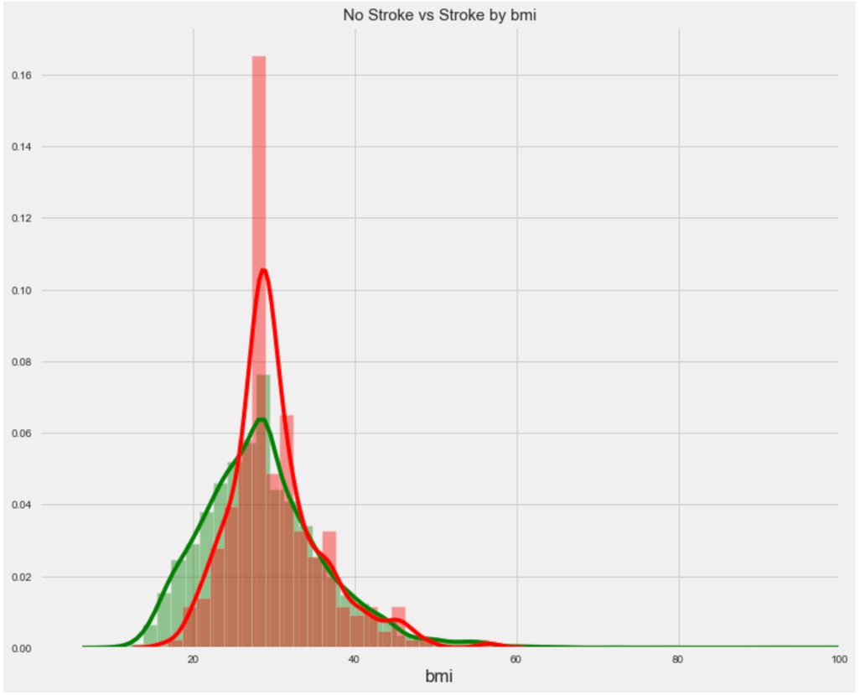
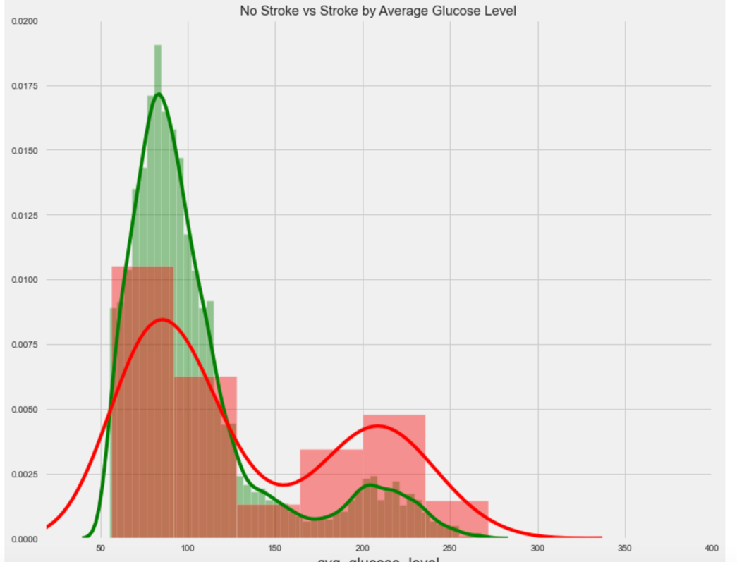
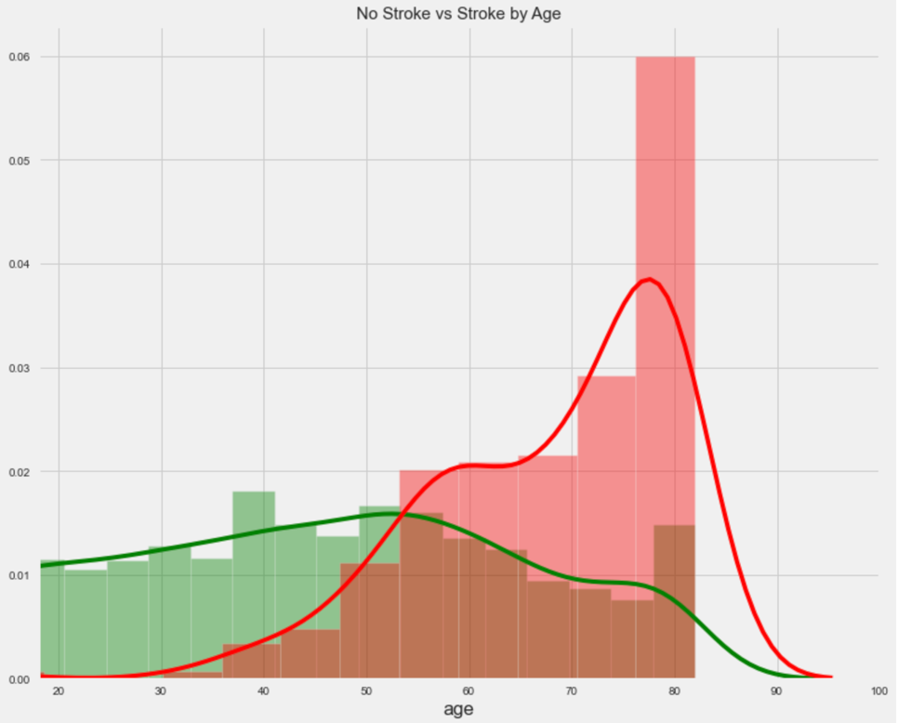
Exploratory Data Analysis

Slide 13
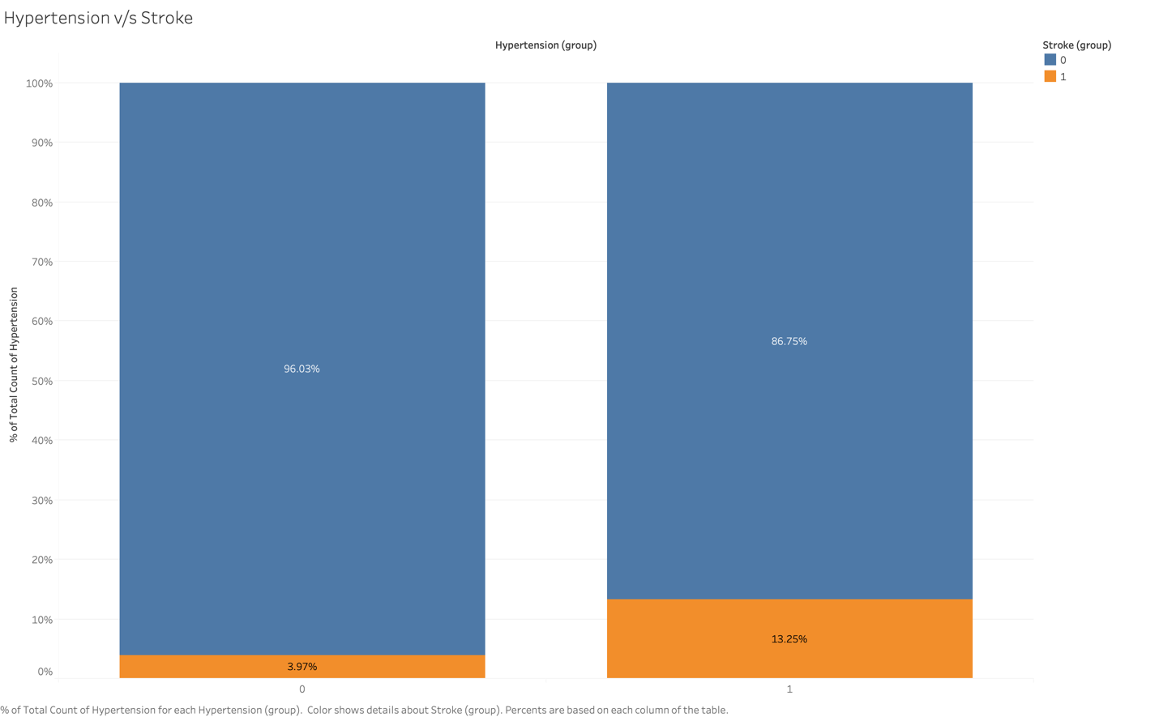
Exploratory Data Analysis

Slide 14
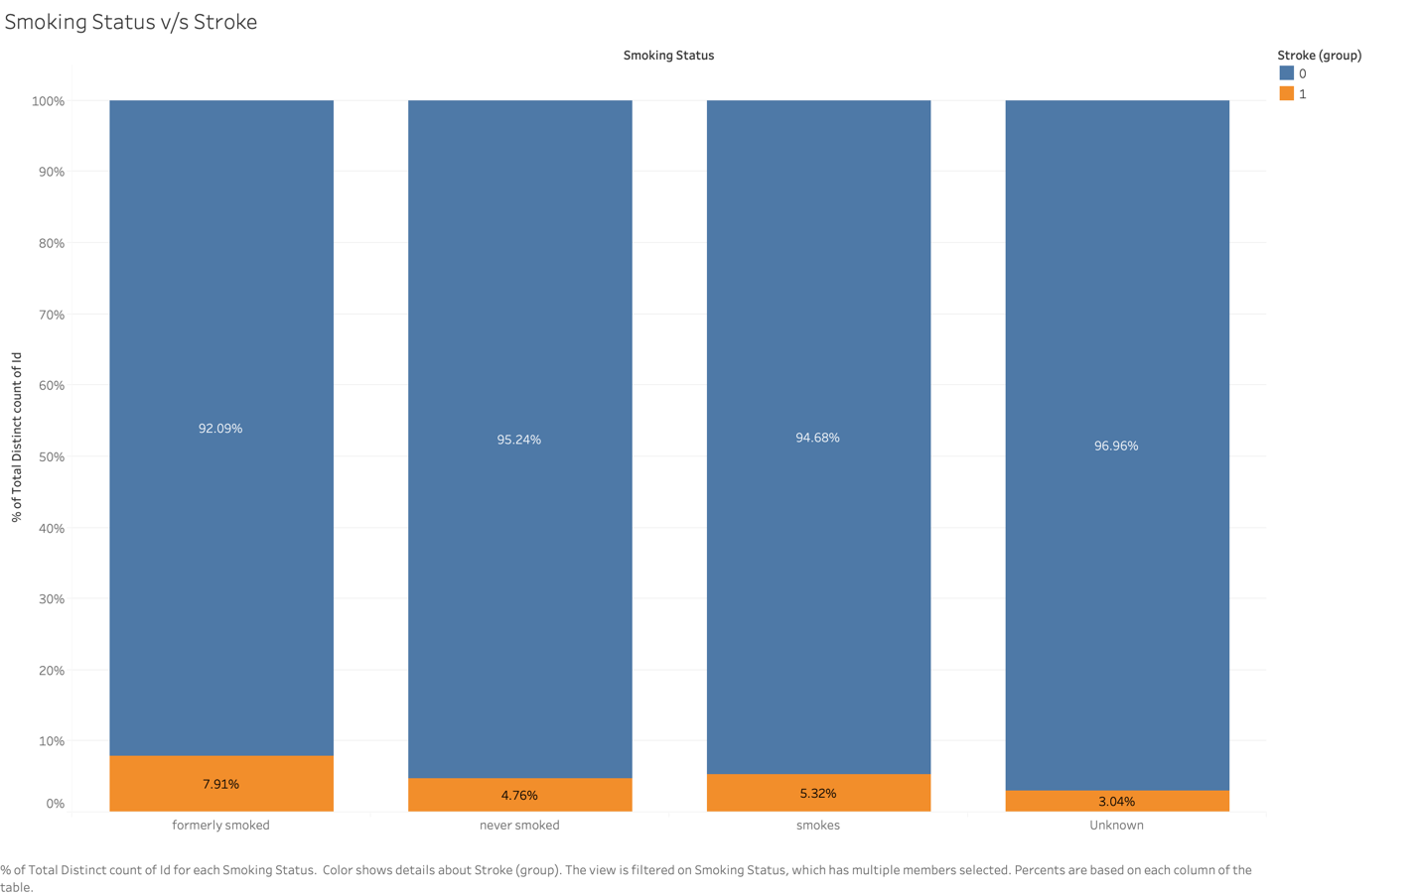
Exploratory Data Analysis

Slide 15
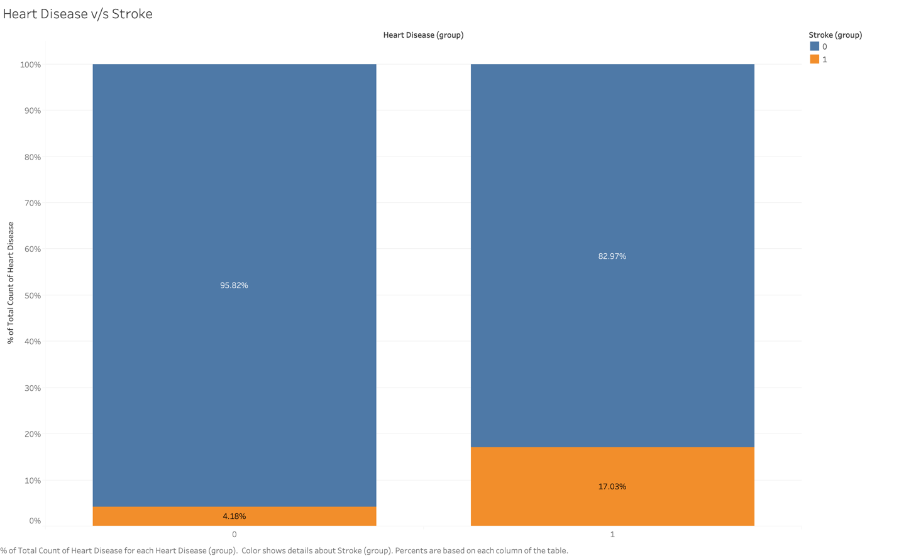
Exploratory Data Analysis

Slide 16
Data Preparation
Oversample minority class with SMOTE function.
Standardized features using RobustScaler function.

Slide 17
model
RF with Seed
RF Parameter – class_weight, max_depth, max_features, n_estimators & bootstrap
Logistic Regression with SelectKBest, Weight, Seed
Logistic Regression Parameter – C, select best
ANN – learning_rate, max_iter, Solver

Slide 18
Model Cross Validation
Models a Tuned, Trained & Cross-Validated using GridSearchCV
No need to calibrate RF based on CalibratedClassifierCV
Selected RF based on Best Accuracy
Model | Best Parameter | Avg Precision Score
RF | class_weight: none | 0.998
 | max_depth: 40
 | max_features: sqrt
 | n_estimators: 200 bootstrap: False
LR | logistic__C: 0.1 | 0.818
 | select_best__k: all
Model | Best Parameter | Avg Precision Score
ANN | learning_rate_init: 0.01 | 0.953
 | max_iter: 300
 | Solver: adam

Slide 19
Model Test
Random Forest Confusion Matrix:
 | Random Forest
Accuracy | 0.91
F1-Score | 0.157
TP: 1119 | TN: 67
FP: 51 | FN:11

Slide 20
Conclusion
All the Models performed Pretty Well.
Accuracy result from Cross validation are close for all the models
Selected Random Forest model based on the Cross-Validation accuracy score and it is easier to explain to all stakeholders.
Trained Random Forest model on Entire Dataset using best Parameter.

Slide 21

Thank you

